Slide 1
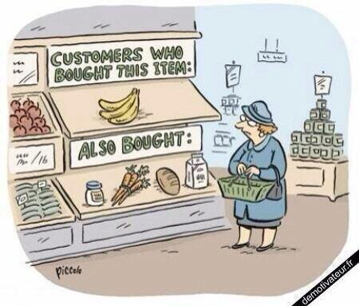
Content Recommendation System
Group Members:
ADIB MOHAMMED – 20201CSG0033
ABHINEET GAUR – 20201CSG0009
SURAJ KUMAR TRIPATHY – 20201CSG0030

Slide 2
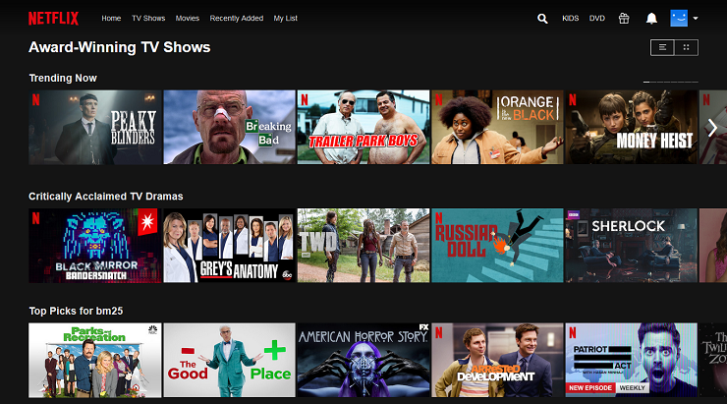
What is Recommendation System?
A recommendation system, also known as a recommender system, is a subclass of information filtering systems that are designed to predict or suggest items that a user might be interested in. Recommendation systems are widely used in various online platforms and applications to enhance user experience and engagement by providing personalized and relevant content. They are based on the idea of making suggestions or recommendations to users by analyzing their preferences and behavior.

Slide 3
Proposed Method
The provided code seems to be part of a movie recommendation project using a collaborative filtering approach. Collaborative filtering recommends items based on the preferences of other users. Here's a proposed method based on the code:
Data Loading and Exploration:
Load movie ratings, user information, and movie details datasets.
Explore and clean the data to handle any missing values or inconsistencies.
Data Visualization:
Generate a word cloud based on movie titles to visualize the most frequent words, providing an overview of the movie dataset.
Use visualizations to explore the distribution of movie ratings.
Genre Analysis:
Identify and count unique movie genres.
Utilize a function to analyze and display the top genres based on their frequency.

Slide 4
Proposed Method
Content-Based Filtering:
Utilize the TF-IDF vectorization technique to convert movie genres into numerical representations.
Calculate cosine similarity between movies based on their genre representations.
User-Item Matrices:
Prepare user-item matrices for both training and testing data.
Movie Recommendations:
Create a function (genre_recommendations) to recommend movies based on their genre similarity.
Demonstrate movie recommendations for specific movies like 'Good Will Hunting (1997)', 'Toy Story (1995)', and 'Saving Private Ryan (1998)'.

Slide 5
Objectives
Explore and understand the movie dataset.
Visualize movie title data using a word cloud.
Analyze movie genres and their frequencies.
Implement content-based filtering using TF-IDF and cosine similarity.
Provide movie recommendations based on genre similarity.

Slide 6
Methodology
Use pandas for data manipulation and exploration.
Visualize data using word clouds, matplotlib, and seaborn.
Implement content-based filtering using scikit-learn's TfidfVectorizer and linear_kernel.
Build user-item matrices for collaborative filtering.
Develop a function for recommending movies based on genre similarity.

Slide 7
Expected Outcomes
Gain insights into the distribution of movie ratings.
Understand the most common genres in the dataset.
Successfully implement content-based filtering for movie recommendations.
Obtain recommendations for specific movies based on genre similarity.

Slide 8
Conclusion
The project aims to provide movie recommendations using collaborative filtering and content-based filtering approaches. By exploring and visualizing the dataset, analyzing genre frequencies, and implementing content-based filtering, the code expects to offer personalized movie suggestions based on user preferences and genre similarities. The effectiveness of the recommendation system can be evaluated based on user feedback and the relevance of recommended movies. Additionally, the project may be extended to incorporate user feedback for continuous improvement.

